Slide 1
LOAN PORTFOLIO ANALYSIS
Data Profiling, Portfolio Analysis & Interactive Dashboard
Tools & technologies
SQL | Microsoft Excel
Dataset: 65,535 loan records
Analysis period: 2016–2020
Project type: Independent Analytics Portfolio Project
Prepared by: Raman Pinate
Project link : https://github.com/ramanp83/loan-portfolio-analysis.git

Slide 2
Project Workflow
Raw Loan Dataset
65,535 records
SQL — Data Profiling
Structure, completeness, uniqueness and data patterns
Excel — Analysis
KPI calculations, PivotTables and portfolio analysis
Interactive Excel Dashboard
Six charts and three interactive slicers

Slide 3
Business Context & Project Objective
Business Context
Loan portfolios contain multiple products, loan statuses, funding amounts and repayment-related indicators. Analysing these together can help stakeholders understand portfolio composition, funding distribution and potential areas requiring further investigation.
Project Objective
To profile and analyse loan-level data using SQL and Excel, develop key portfolio KPIs, and create an interactive dashboard for monitoring portfolio composition and performance indicators.
Key Business Questions
  How is the loan portfolio distributed across loan statuses?
  Which products contribute most to the funded portfolio?
  How does loan funding vary over time?
  What does the loan amount distribution look like?
  What risk-related indicators can be observed in the available data?

Slide 4
Dataset Overview
65,535
Loan records
2016–2020
Data period
78
Product IDs
9
Loan status categories
Main Data Dimensions
  Loan and account identifiers
  Client information
  Loan product details
  Funded amount and loan amount
  Disbursement date and year
  Loan status
  Grade and sub-grade
  Delinquency-related fields

Slide 5
SQL Data Profiling & Quality Checks
What I examined using SQL
Dataset structure and record counts
Unique Account IDs and Client IDs
Missing values in important fields
Distribution of loan attributes
Relationships between selected fields
Data completeness across loan statuses and years
Important observations
65,535 loan records were profiled.
Account ID and Client ID were each unique within the dataset.
Grade and Sub Grade were missing together in 25,818 records.
Client names were not reliable unique identifiers; identical names could have different client attributes.

Slide 6
Portfolio KPI Framework
KPI | Result
Gross Funded Portfolio | ₹73.27 M
Funding Shortfall Rate | 4.67%
Portfolio Realized Yield | 21.21%
Active Loan Delinquency Proxy | 10.68%
NPA + Write-Off Record Rate | 0.94%
Total Loan Records | 65,535

Slide 7
Analytical Approach
SQL
Profiled the data and checked completeness and uniqueness.
Explored distributions and relationships between loan attributes.
Excel
Built the data model and calculated KPIs.
Created PivotTables to analyse:
  Loan status
  Funded amount by loan status
  Product-level funding and loan counts
  Annual and monthly funding trends
Loan amount ranges
Created PivotCharts and interactive slicers.
Validated that the dashboard filters updated all six charts.

Slide 8
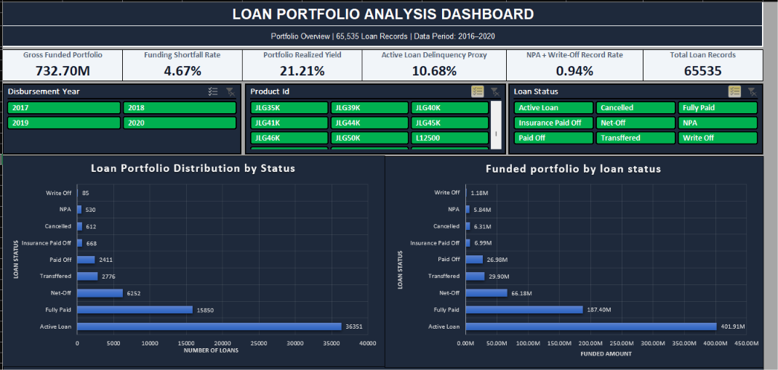
Interactive Loan Portfolio Dashboard
Dashboard components
Six KPI cards
Loan portfolio distribution by status
Funded portfolio by loan status
Product-level funding analysis
Annual loan portfolio trend
Monthly funded amount trend
Loan distribution by amount range
Interactive filters
Disbursement Year
Product ID
Loan Status

Slide 9
Key Findings
1. Portfolio composition
Active Loans account for 36,351 records, or approximately 55.46% of all loan records.
2. Product concentration
JLG30K and JLG35K together account for ₹59.03 Cr, approximately 80.57% of the total funded portfolio.
3. Loan volume concentration
These two products represent 52,170 loan records, approximately 79.60% of all records.
4. Portfolio timeline
The dataset covers 2016–2020, but 2016 and 2020 are partial-year periods. Annual comparisons need to account for this.
5. Loan amount distribution
The ₹5,000–₹9,999 loan amount range has the highest record count, with 19,667 loans.

Slide 10
Recommendations & Future Scope
Potential business follow-ups
  Monitor the high funded-amount concentration in JLG30K and JLG35K.
  Review active loan delinquency indicators by product and disbursement year.
  Investigate the missing Grade and Sub Grade values.
  Compare portfolio trends using complete-year periods where possible.
  Track portfolio KPIs regularly as new loan records become available.
Project limitations
  The dataset is a historical extract covering 2016–2020.
  2016 and 2020 contain partial-year data.
  Grade and Sub Grade are missing in 25,818 records.
  Some risk measures are proxies based on the available fields.
  The analysis does not establish why a loan became delinquent or prove causation.
  No live banking system or current loan performance data was connected.

Slide 11
Conclusion
This project demonstrates an end-to-end analytical workflow using SQL and Excel.
  Used SQL to profile the loan dataset and assess data quality.
  Used Excel to calculate portfolio KPIs and conduct segmented analysis.
  Developed an interactive dashboard to explore loan status, products, funding trends and loan amounts.
  Identified portfolio concentration patterns and areas for further investigation.
Key takeaway: Data analysis is not only about presenting numbers; it is about turning data into understandable findings that can support better business questions and decisions.

